Slide 1
Sorting and selection
School of Artificial Intelligence

Slide 2
Previously on Binary search trees
Binary Search Tree
Performance: O(h)
Balancing search tree
Rotation
X-Y rotation
Trinode rotation
AVL tree
Height of AVL tree: number of nodes in a path
Height balance property
Splay tree
Splay operations: search, add, remove
2-4 tree
Multi-way search tree
Red black tree
Balanced search tree constraint by 3 main properties

Slide 3
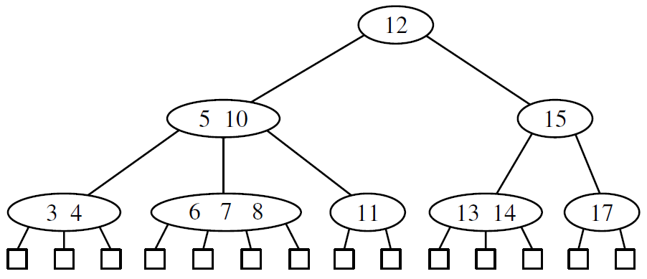
(2,4) Trees
Sometimes 2-4 tree or 2-3-4 tree
Size property: every internal node has at most four children
Depth property: all external nodes have the same depth
The height of a 2-4 tree storing n items is O (log n)
Sufficient to keep the tree balanced
Search takes O(log n) time

Slide 4
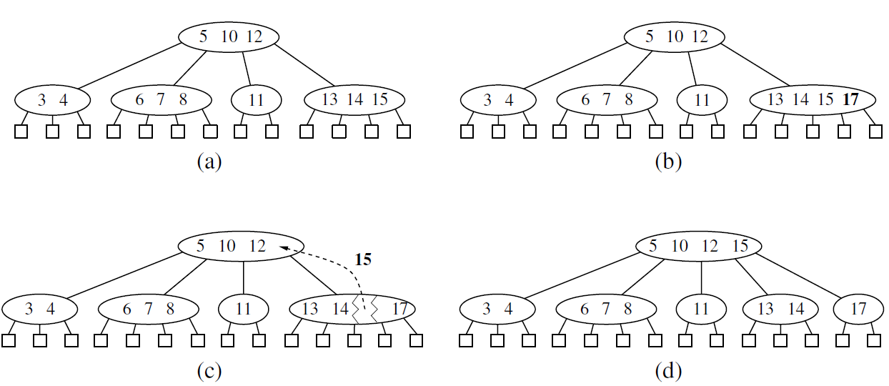
(2,4) Trees insertion
Node split

Slide 5
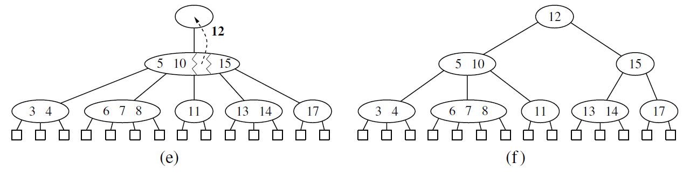
(2,4) Trees insertion
Node split

Slide 6
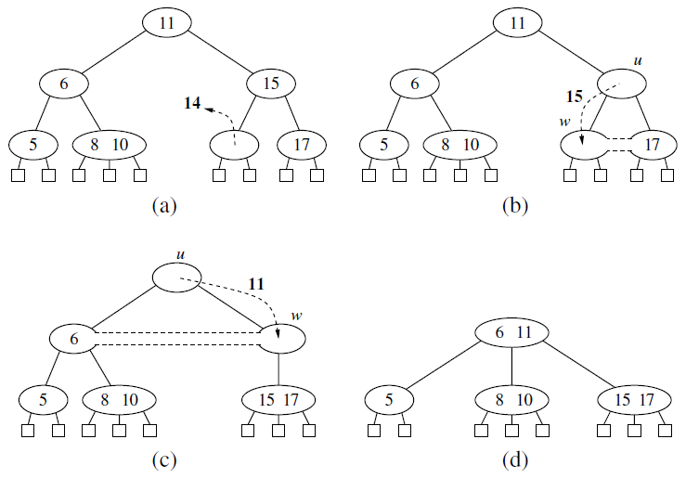
(2,4) Trees Deletion
Fusion at node w may cause a new underflow to occur at the parent u of w, which triggers a transfer or fusion at u
Number of fusion operations is bounded by the height of the tree – O(log n)

Slide 7
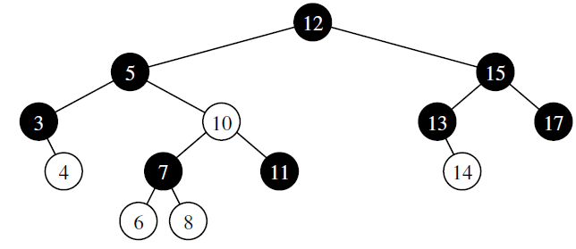
Red-black trees
AVL trees – need to perform rotations
2-4 trees – need to perform split and fusion operations
Red-black trees: O(1) structural changes after an update to stay balanced
Red-black tree
Binary search tree, nodes coloured
Root property: root is black
Red property: the children of a red node are black
Depth property: all nodes with zero or one children have the same black depth
Black depth: number of black ancestors

Slide 8
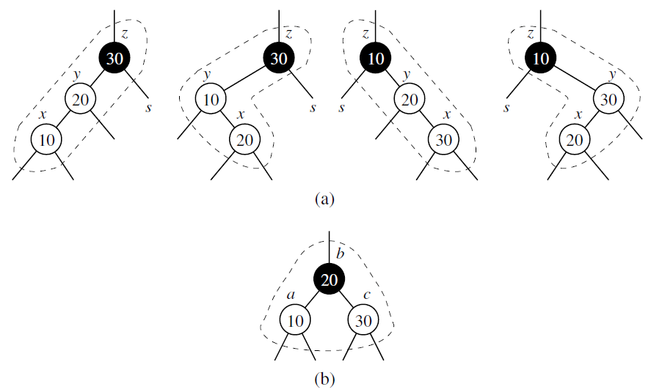
Red-black trees insertion
Case 1: The sibling s of y is black (or None)
Trinode restructuring
Node x, y, z
Label them a, b, and c
Replace z with the node labeled b and make nodes a and c the children of b
Colour b black and a and c red

Slide 9
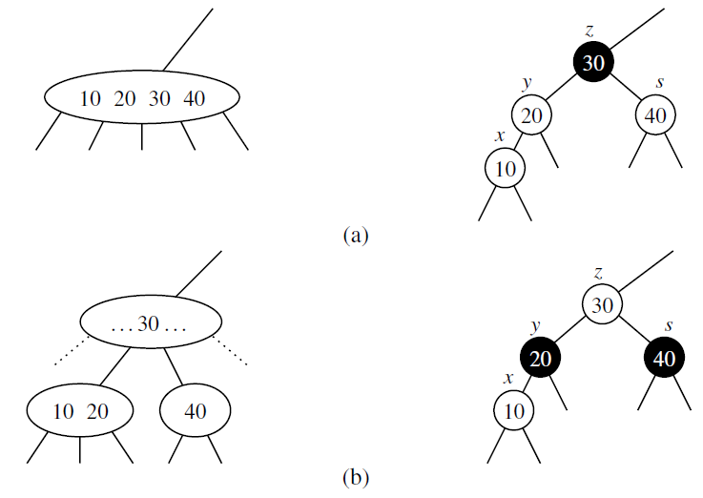
Red-black trees insertion
Case 2: sibling s of y is red
Overflow in its equivalent 2-4 tree
Fix: split/recolouring
Colour y and s black and their parent z red
If z is root, it remains black
Unless z is the root, the portion of any path through the affected part of the tree is incident to one black node

Slide 10
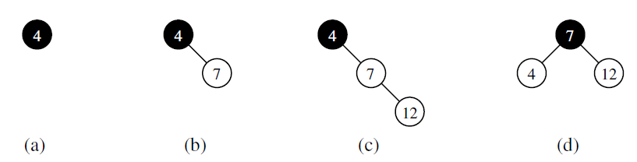
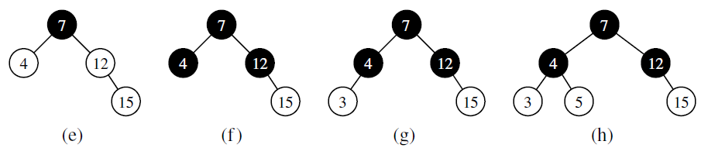
Red-black trees insertion

Slide 11
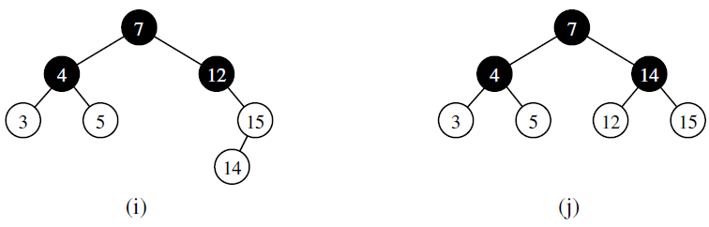
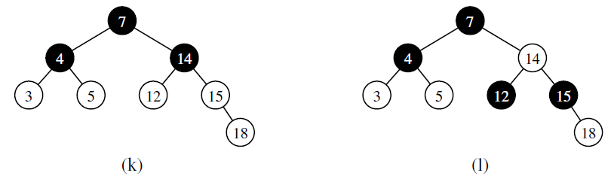
Red-black trees insertion

Slide 12
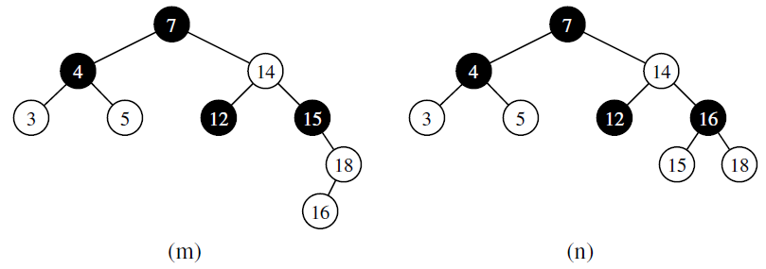
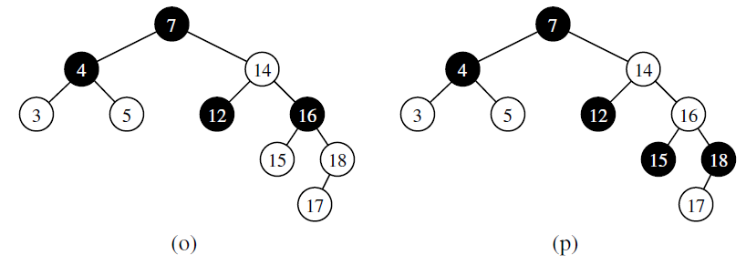
Red-black trees insertion

Slide 13
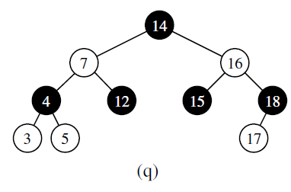
Red-black trees insertion

Slide 14
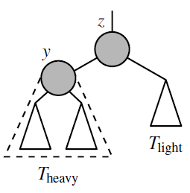
Red-black trees deletion
Search – O(log n)
If removed node is red – no affect on the black depth property, or red violations
If removed node is black and has one child that was a red leaf
Recolour solves the problem
If removed node is a black leaf
Black deficit of 1
Removed node must have a sibling whose subtree has black height 1
More general setting with a node z with two subtrees: T heavy and T light. Black depth of T heavy is one more than T light
Z: parent of removed leaf
Y: root of T heavy

Slide 15
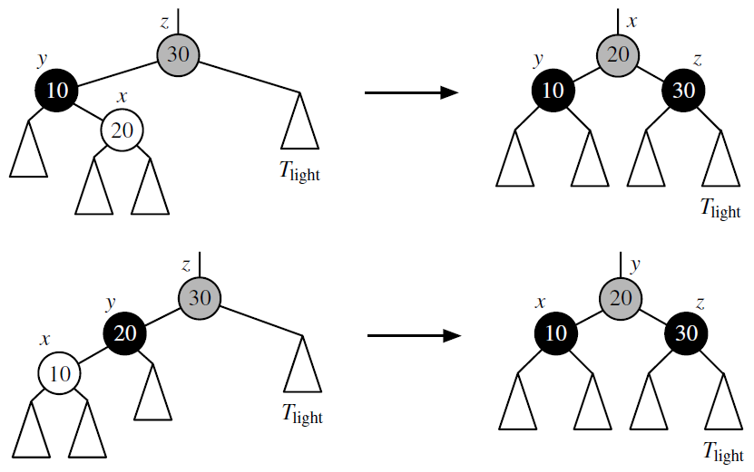
Red-black trees deletion
Case 1: node y is black and has a red child x
Trinode restructuring:
x, y and z
a, b and c
Make b the parent of the other two
Colour a and c black
Give b the previous colour of z

Slide 16
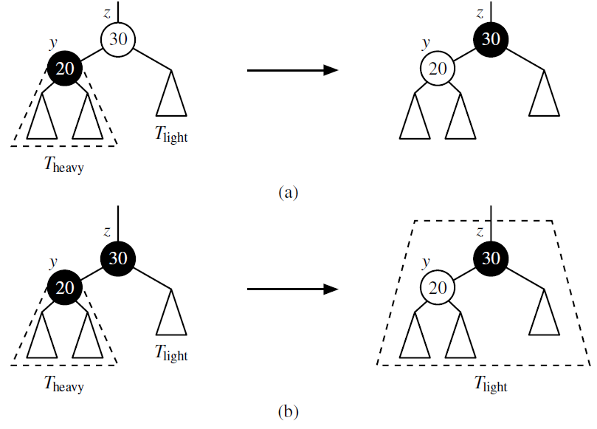
Red-black trees deletion
Case 2: node y is black and both children of y are black(or None)
Recolouring: colour y red and if z is red, colour it black
Z becomes deficient, repeat consideration of all three cases at the parent of z as a remedy

Slide 17
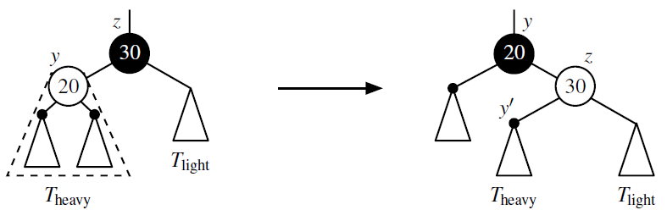
Red-black trees deletion
Case 3: node y is red
Rotation about y and z
Recolor y black and z red
Repeat step 1, 2 and 3 if necessary

Slide 18
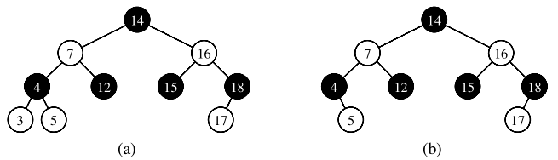
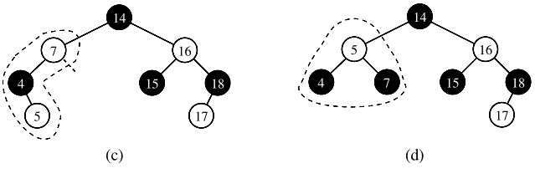
Red-black trees deletion

Slide 19
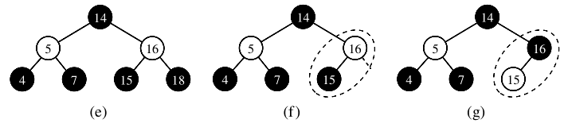
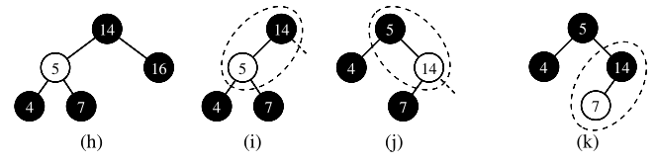
Red-black trees deletion

Slide 20
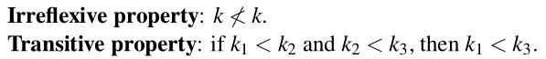
This lecture
Sorting algorithms
Rearrange a collection of elements so that they are ordered from smallest to largest
Such an order exists in Python: the < operator
Most important and well studied computing problem
Data sets are often stored in sorted order to allow for efficient searches
E.g. binary search algorithm
Python: built-in support for sorting data
sort()

Slide 21
Sorting algorithm
Sorting algorithms we have seen so far
Insertion-sort
Selection-sort
Bubble-sort
Heap-sort
Merge-sort

Slide 22
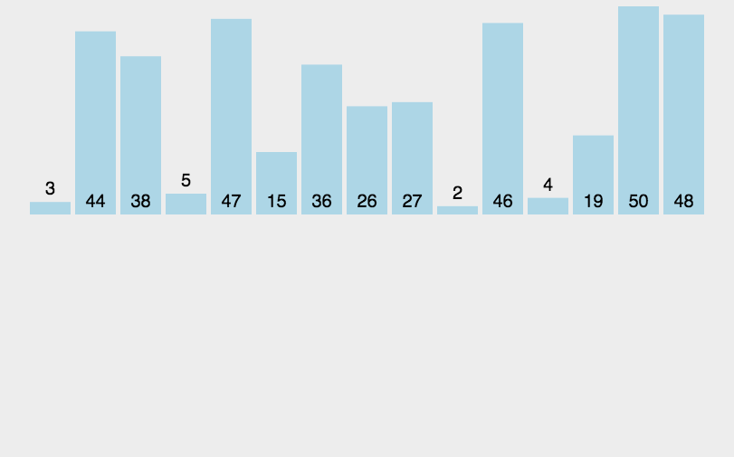
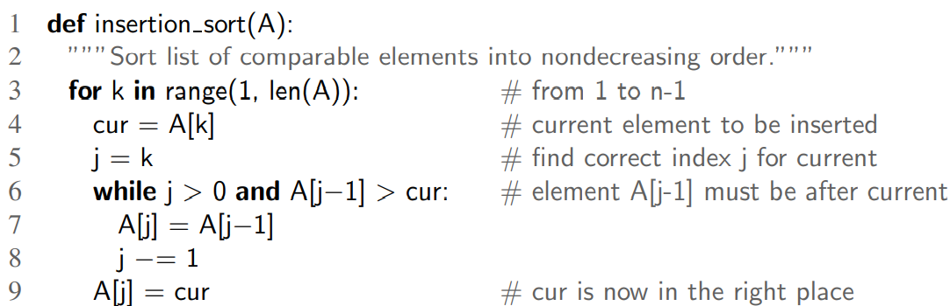
Insertion Sort
Insertion sort

Slide 23
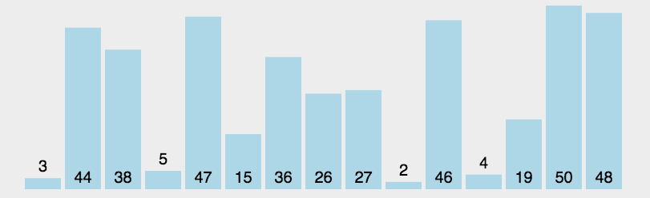
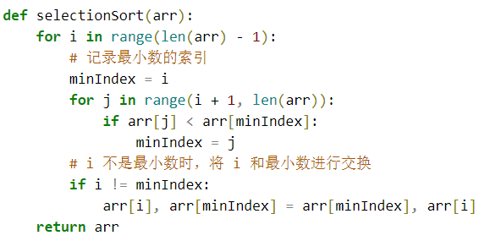
Selection Sort
Selection sort
We have seen this
In Priority Queue

Slide 24
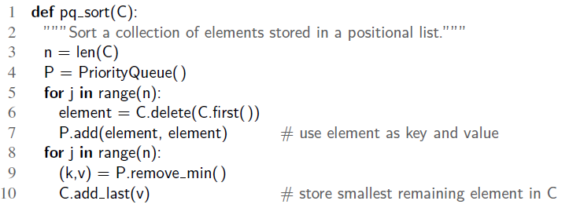
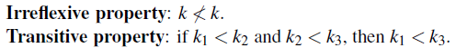
Sorting with a priority queue
Priority queue ADT: any type of object can be used as a key, as long as they can be compared with the comparison operator <
Comparison operators need to be irreflexive and transitive
Use priority queue to sort a collection C of comparable elements.
Insert all elements into an empty priority queue, and call remove_min to get an increasing order

Slide 25
Sorting with a priority queue
pq_sort(): works OK, but its complexity?
Depends on add() and remove_min()
Selection-Sort: implement P with an unsorted list
add() takes O(n) time in total since it is O(1) for add()
remove_min(): selecting element to dequeue()
Total running time: O(n + (n-1) + (n-2) + … + 1) = O(n²)
Insertion-Sort: implement P with a sorted list
remove_min() takes O(n) time in total since it is O(1) for each remove_min()
add(): finding the proper place to add takes O(n²) time in total

Slide 26
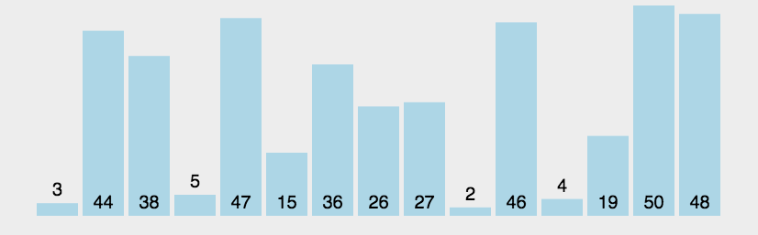
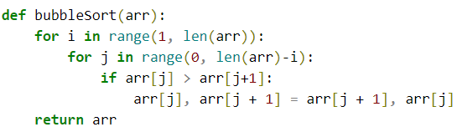
Bubble sort
Bubble sort

Slide 27
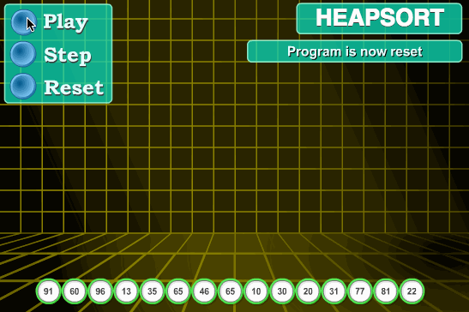
Heap sort
Heap sort

Slide 28
HEAP（堆）
Heap: a binary tree that stores a collection of items at its positions
A relational property defined in terms of the way keys are stored in T
A structural property defined in terms of the shape of T itself
Relational property (heap order property): In a heap T, for every position p other than the root, the key stored at p is greater than or equal to the key stored at p’s parent
Structural property (complete binary tree property): A heap T with height h is a complete binary tree if levels 0, 1, 2, …, h-1 of T have the maximum number of nodes possible (level i has 2^{i} nodes, for 0<= i <= h-1) and the remaining nodes at level h reside in the lfeftmost possible positions at that level

Slide 29
Heap sort
Implementing in-place heap-sort （原地堆排序）
Need to modify the algorithm
Maximum-oriented heap: each position’s key being at least as large as its children. At any time during the execution, use the left portion of C, up to a certain index i-1, to store the entries of the heap, and the right portion of C, from i to n-1, to store the elements of the sequence
In the first phase of the algorithm, start with an empty heap and move the boundary between the heap and the sequence from left to right, one step at a time.
In the second phase of the algorithm, we start with an empty sequence and move the boundary between the heap and the sequence from right to left, one step at a time.

Slide 30
Merge Sort
Divide and conquer
Divide: if the input size is smaller than a certain threshold, solve the problem directly. Otherwise, divide the input data into two or more disjoint subsets
Conquer: recursively solve the sub-problems associated with the subsets
Combine: take the solutions to the sub-problems and merge them into a solution to the original problem

Slide 31
Merge Sort
Divide and conquer for sorting
Divide: if S has zero or one element, return S. Otherwise, remove all the elements from S and put them into two sequences, S1 and S2, each containing half of the elements of S
Conquer: recursively sort sequence S1 and S2
Combine: put back the elements into S by merging the sorted sequences S1 and S2 into a sorted sequence

Slide 32
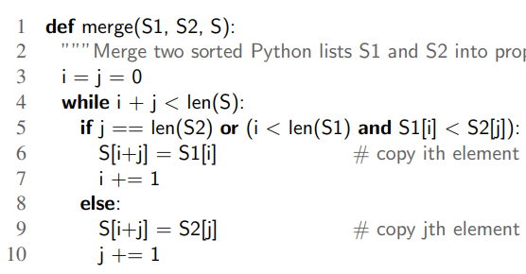
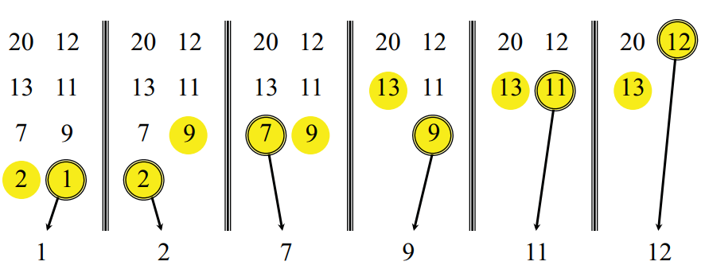
Merge Sort
Merge sort

Slide 33
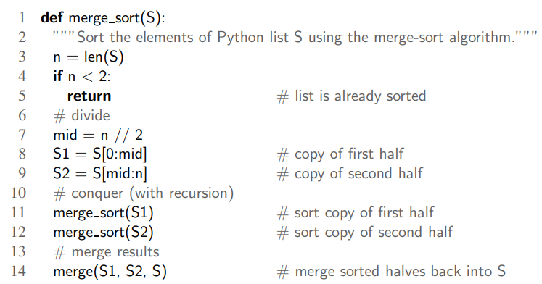
Merge Sort
Merge sort

Slide 34
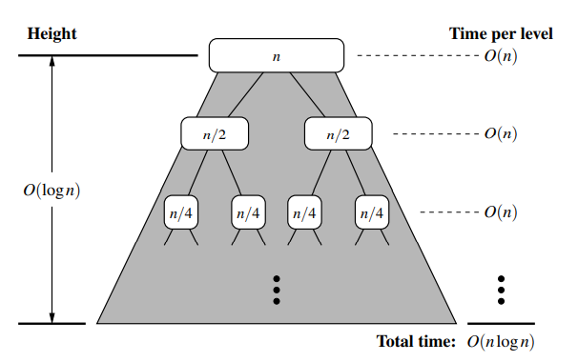
Merge sort
merge_sort(A[1..n])
If n = 1, done
recursively sort A[1..n//2], A[n//2+1..n]
Merge the two sorted list
Notes:
Index 0

Slide 35
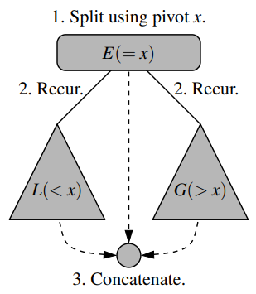
Quick Sort
Divide: if S has at least two elements, select a specific element x from S, which is called the pivot(枢纽). The common practice is to choose the last element of S. Remove all the elements from S and put them into three sequences:
L, storing elements in S less than x
E, storing elements in S equal to x
G, storing elements in S greater than x
Conquer: recursively sort sequences L and G
Combine: Put back the elements into S in order by first inserting the elements of L, then E, then G
Notes:
Index 0

Slide 36
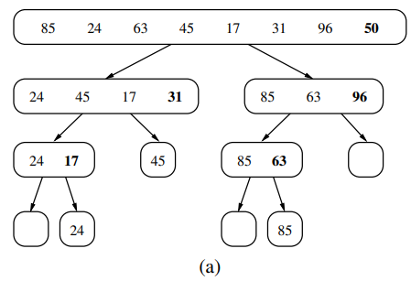
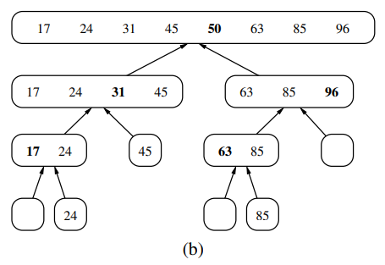
Quick Sort
Notes:
Index 0

Slide 37
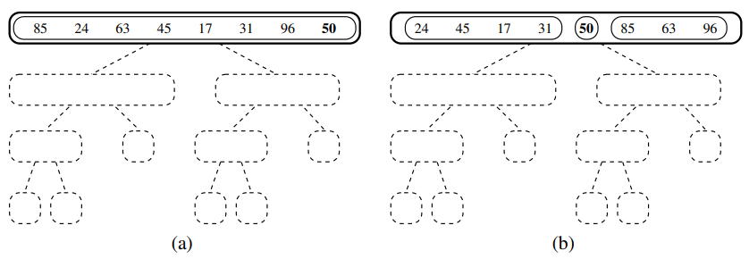
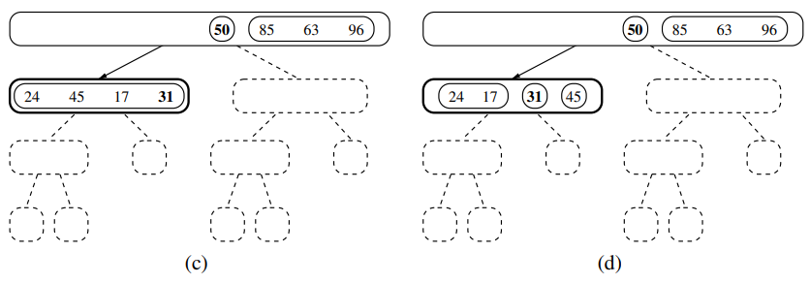
Quick Sort
Notes:
Index 0

Slide 38
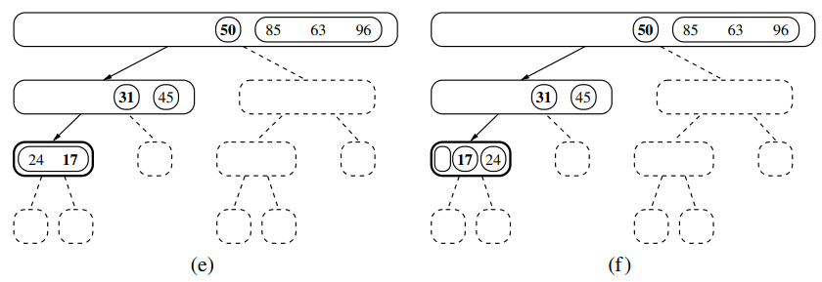
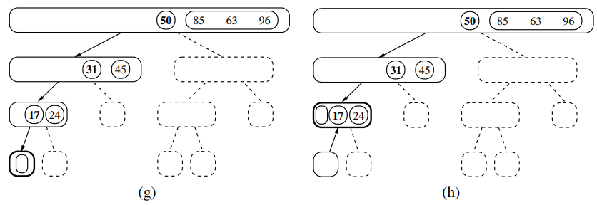
Quick Sort
Notes:
Index 0

Slide 39
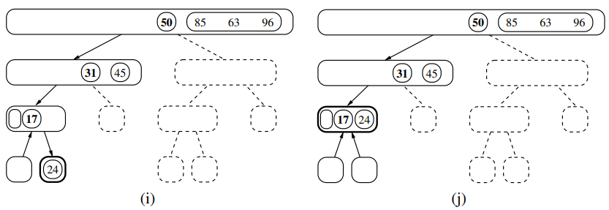
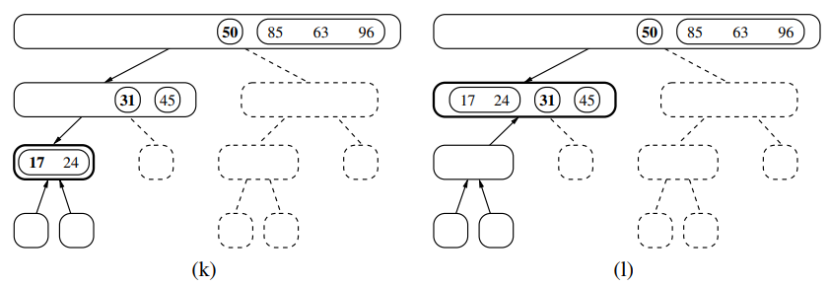
Quick Sort
Notes:
Index 0

Slide 40
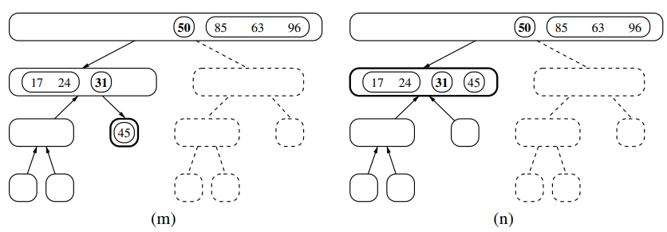
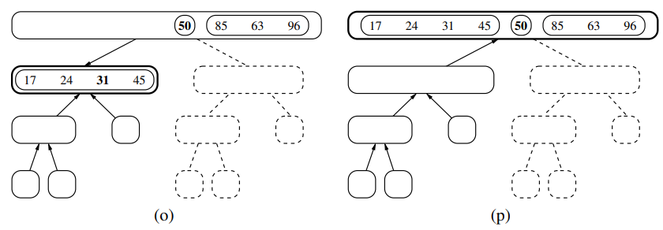
Quick Sort
Notes:
Index 0

Slide 41
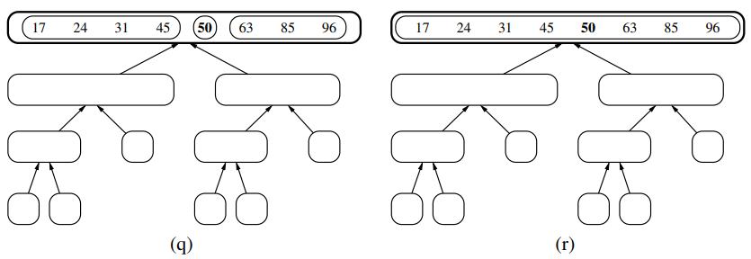
Quick Sort
Notes:
Index 0

Slide 42
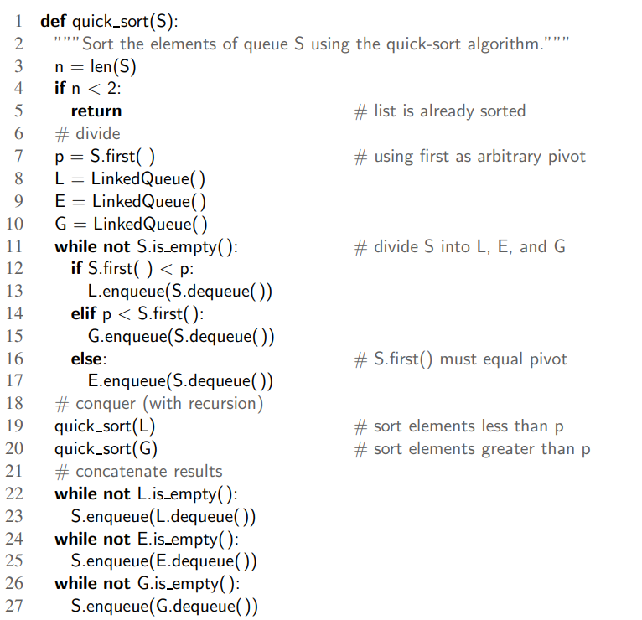
Quick Sort
Height of the quick-sort tree: linear in the worst case
Why?
For an already-sorted sequence of n elements
Height = n-1
Running time:
Worst case: O(n²)
Best case: O(n log n)
Selection of Pivot: last element of S
Improved selection method: pick Pivot at random in S
Expected running time: O(n log n)
Notes:
Index 0

Slide 43
Thanks
See you in the next session!

